Slide 1
facets
What is FACETS?
FACETS is used by healthcare payers (insurance companies) to manage various aspects of healthcare plans, claims processing, and member services. It is an enterprise-level system designed to streamline operations and improve the efficiency of healthcare insurance organizations.
Key Features of FACETS in the context of healthcare claims processing:
Claims Adjudication: FACETS automates the process of claims adjudication, which includes determining the amount the insurance company is responsible for paying based on the patient’s plan, coverage, and other factors.
Eligibility and Enrollment: The system helps manage member enrollment and eligibility checking for insurance plans. It ensures that the claims are processed based on the correct benefits and eligibility.
Billing and Invoicing: FACETS helps in managing premium billing, invoicing, and payments for members and groups.
Provider Network Management: It assists in maintaining relationships with healthcare providers, including processing payments to them and ensuring accurate claims submission.
Member and Provider Portals: FACETS often includes self-service portals for both members and providers, allowing easy access to information regarding claims, benefits, and services.
Overall, FACETS helps healthcare organizations manage the entire lifecycle of health insurance claims, from eligibility verification to payment, improving operational efficiency and reducing errors in the claims process.

Slide 2
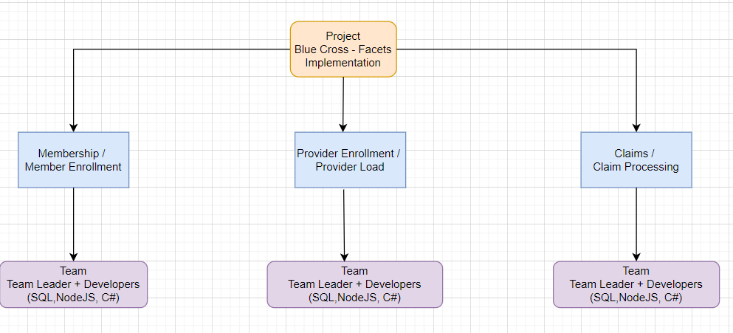
Project - FACETS implementation
Blue Cross NC have done with transition of its Medicare Advantage and Medicare Supplement claims operations to Facets on January 1, 2024.
About – The project was about implementing FACETS system for all BCBS members.
For this particular project
I was a part of Claims team.
There we were having team of around
20 people.
Once the claims has been submitted for
processing the system was developed to
process all those claims automatically without
manual intervention.
I worked some modules within this
like Member match process,
Provider Selection process,
claims preprocessing for date validations
and for some of the payment process
as well.

Slide 3
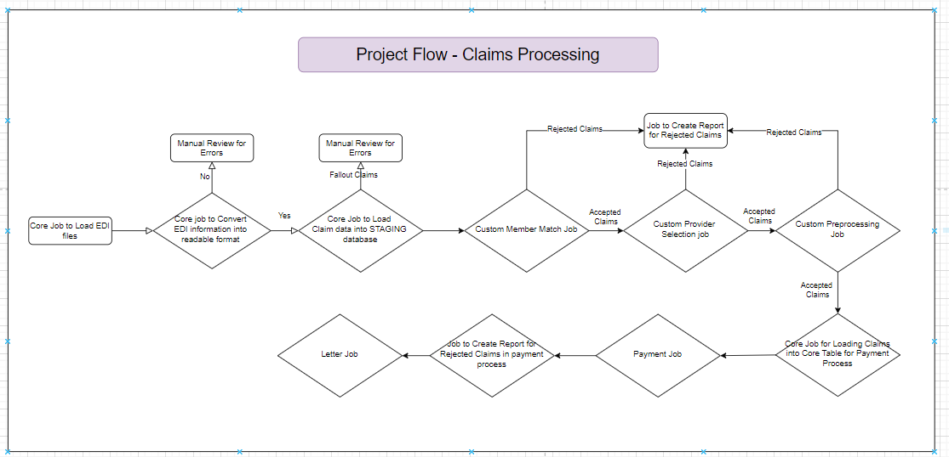
Claims Processing – Flow Diagram

Slide 4
Work Process – Project Management
Project Management Methodologies:
A project management methodology is a set of principles, tools and techniques that are used to plan, execute and manage projects. Project management methodologies help project managers lead team members and manage work while facilitating team collaboration.
Commonly Used Methodologies:
Scrum
Kanban
Six Sigma
Agile
Waterfall
Project Management Tools:
JIRA is widely used in software development.
Below are some of the Project Management tools used:
JIRA
AzureDevops
ClickUp
Smart Sheet
Microsoft Project

Slide 5
Work Process – Project Management
Ticketing Tools
Version Control System
There are several tools similar that offer version control, CI/CD (Continuous Integration/Continuous Deployment), and DevOps capabilities. These tools help manage source code, automate testing, and streamline the development workflow. Here are some of the most notable ones:
Gitlab
Github
AzureDevops
BitBucket
There are numerous ticketing and IT service management (ITSM) tools.
These tools help organizations track and manage issues, requests, and incidents, providing a streamlined way to support internal or external users.
ServiceNow
Jira Service Management
Top Desk
RemedyForce

Slide 6
Work Process – Project Management
Schedular
IT automation and job scheduling platform helps enterprises automate complex workflows across various systems, applications, and environments (on-premise, cloud, and hybrid). There are several similar tools that provide job scheduling, workload automation, and orchestration features.
Control-M
Stonebranch
Azure logic Apps
Cisco Workload Automation

